Slide 1
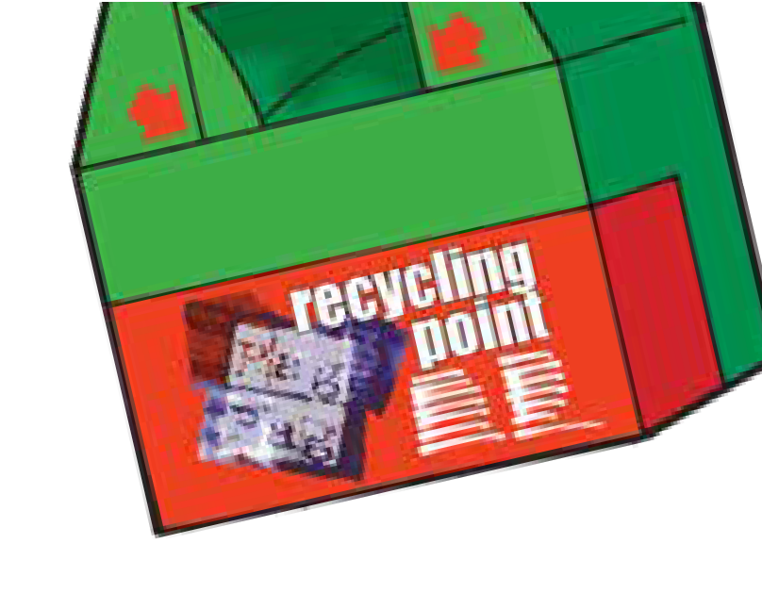




Raise £300 per tonne
for your school.
EXCITING NEWS! St Erth School is participating in the Rag Bag textile recycling scheme which provides regular fundraising for our school and raises awareness about recycling.
Please bring any of the below unwanted items in a securely tied plastic bag to your indoor or outdoor textile bank on site.
Rag Bag can accept good quality clean Men’s, Ladies and Children’s clothing, belts, bags and paired shoes (tied together).
The bags will be collected when the bank is full and trans- ported to the Rag Bag factory where they will be sorted and graded for reuse or recycling.

